Slide 1
11th International Conference on Isogeometric Analysis
Ikarus with dune-iga: An open source C++ library for Isogeometric Analysis within the DUNE framework
Lyon, France
18 – 21 June 2023
A. Müller, H. Jakob, T.K.M. Vinod Kumar Mitruka*, O. Sander, M. Bischoff

Slide 2
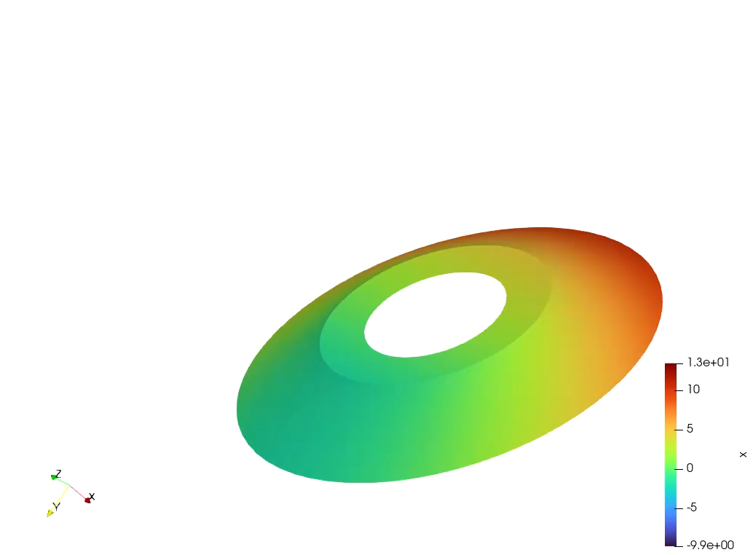
Ikarus with dune-iga
Surface Of Revolution

Slide 3
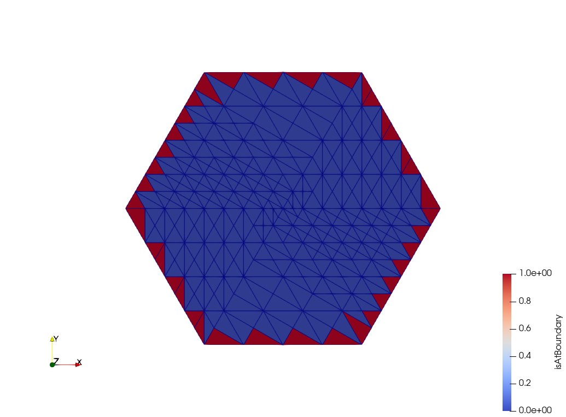
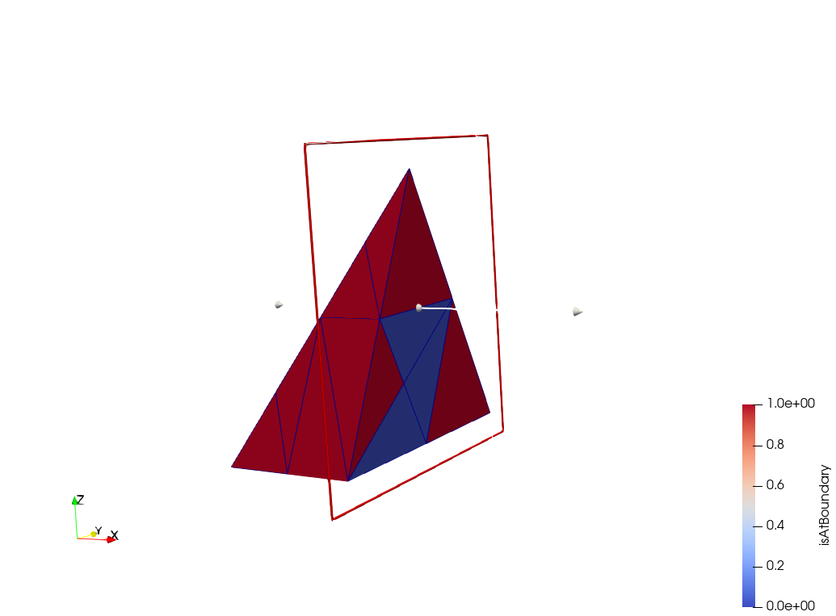
Ikarus with dune-iga
Mark elements on boundary

Slide 4
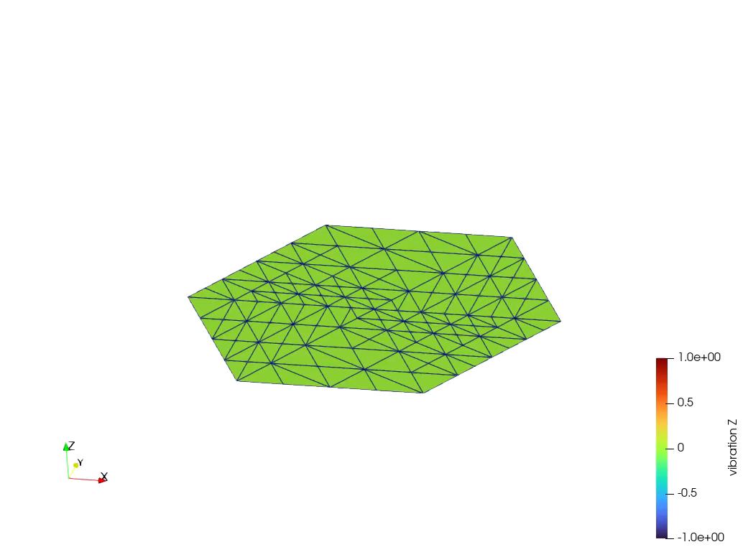
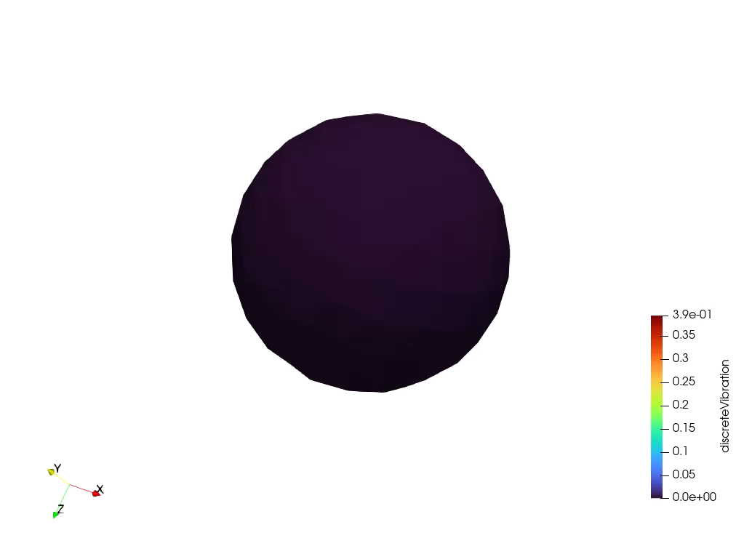
Ikarus with dune-iga
Interpolate functions on Grids

Slide 5
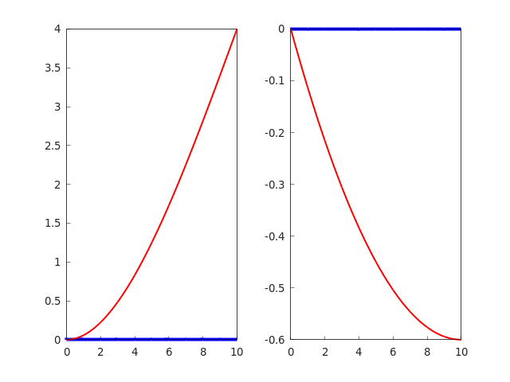
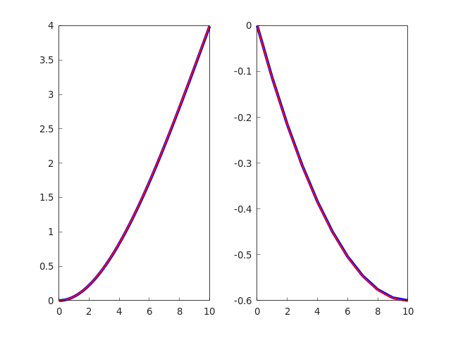
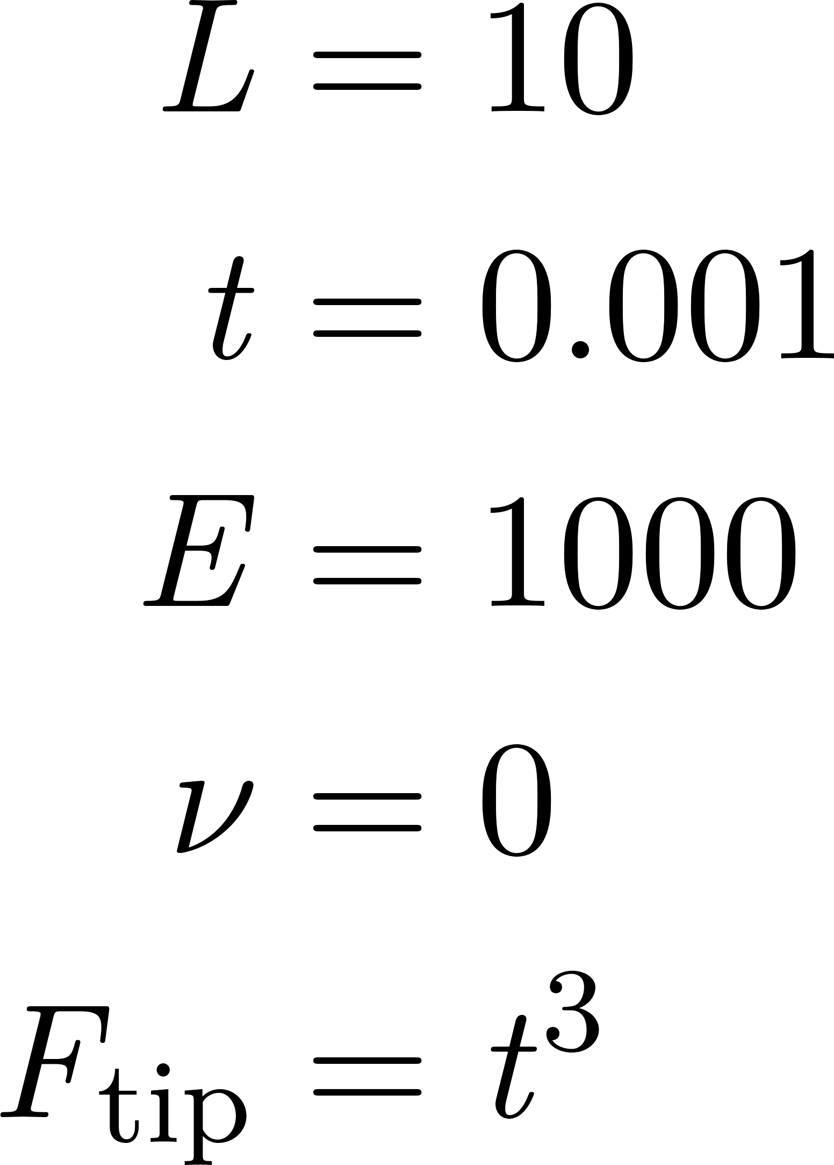
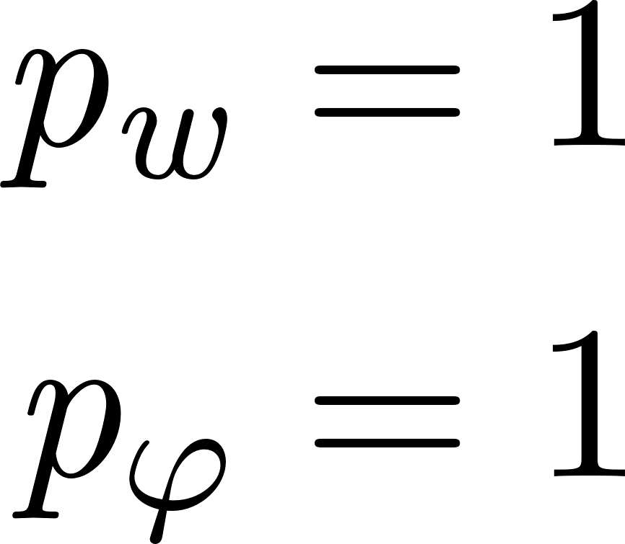
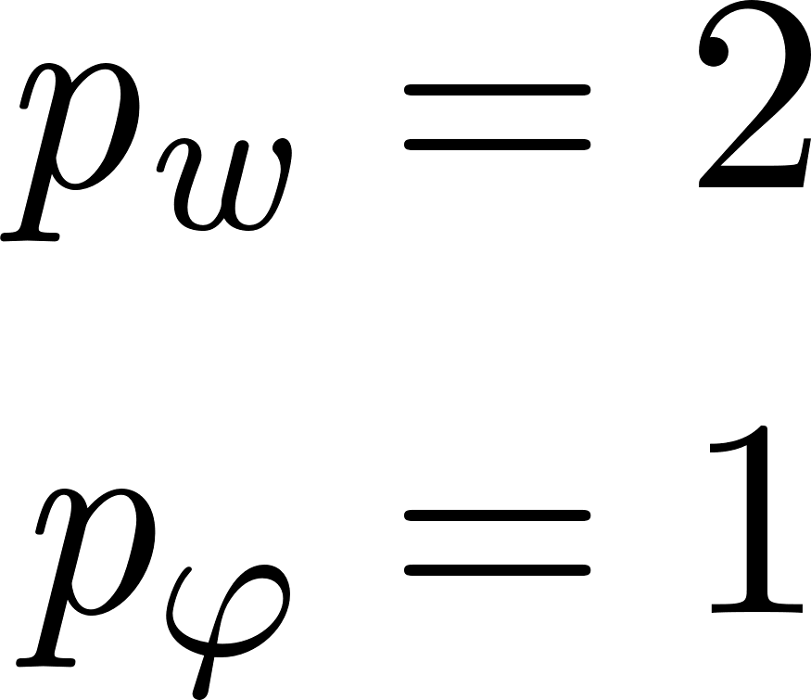



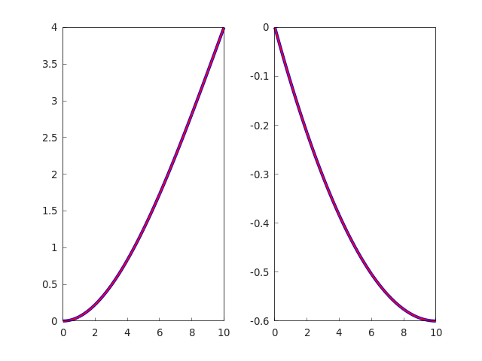
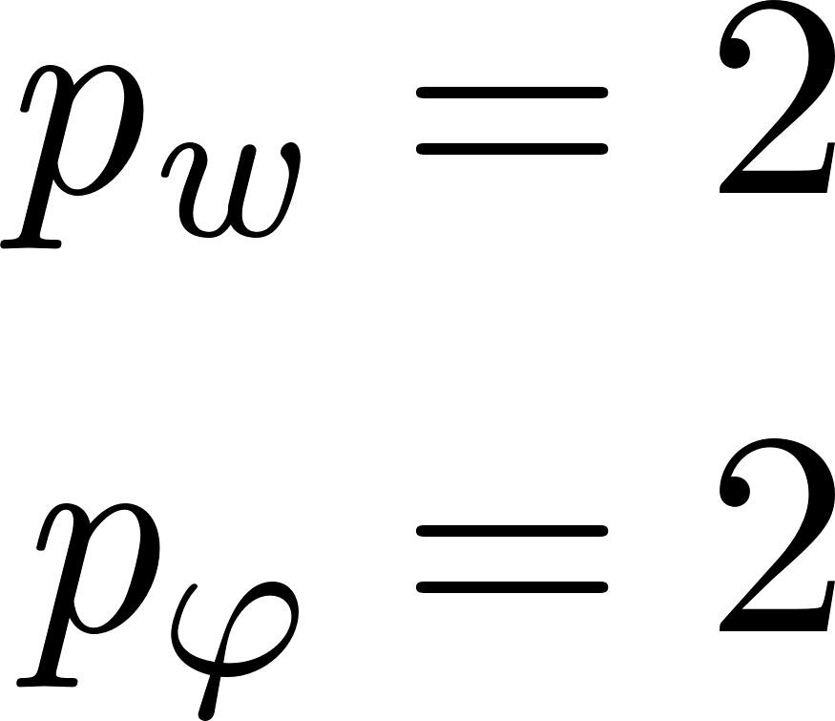

Ikarus with dune-iga
Cantilever Beam With Tip Load
Exact
FE

Slide 6
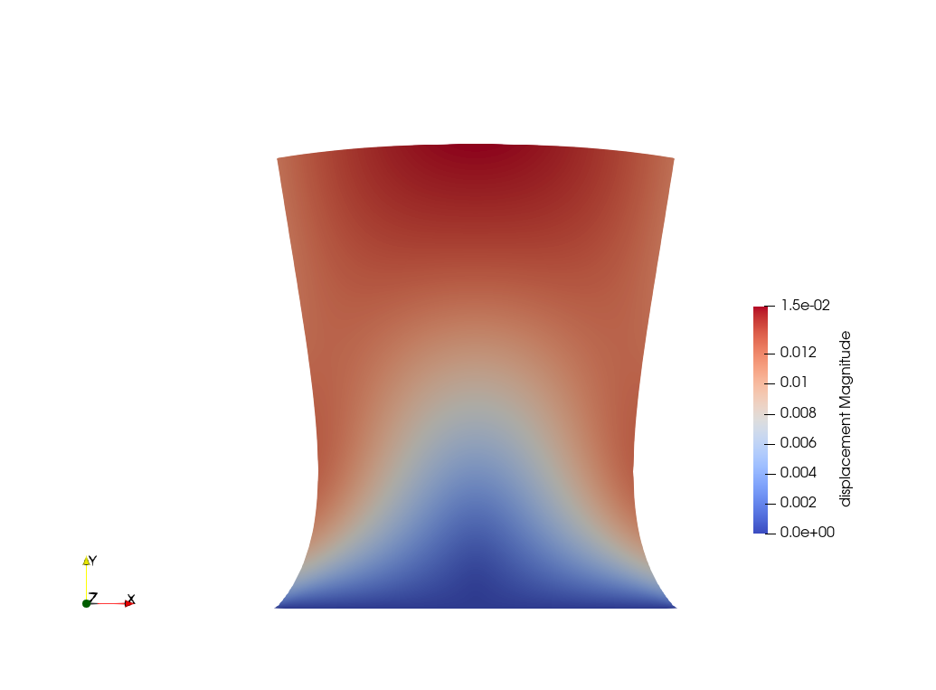
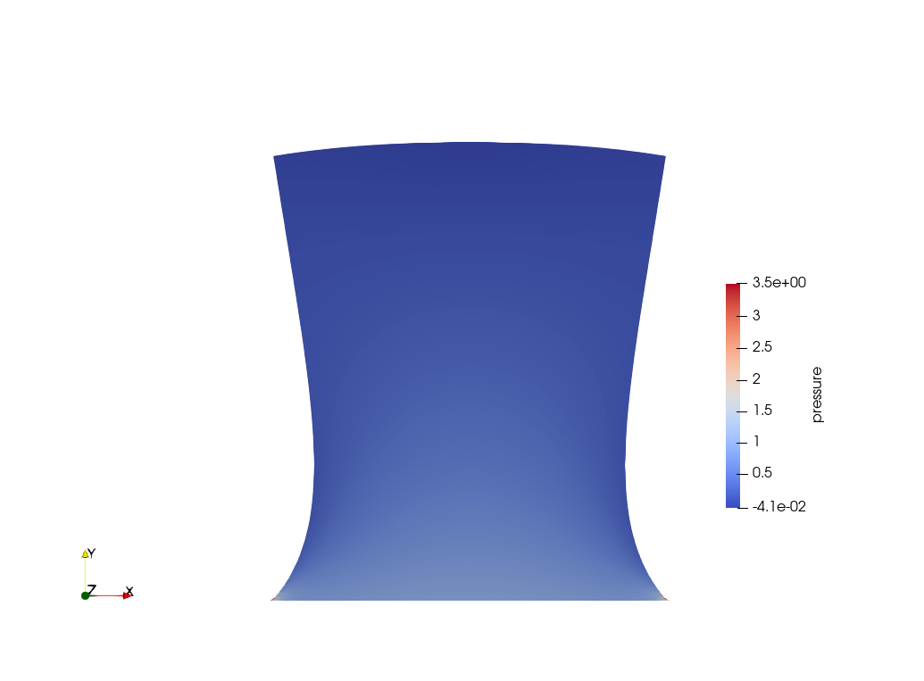
Ikarus with dune-iga
Incompressible Linear Elasticity

Slide 7
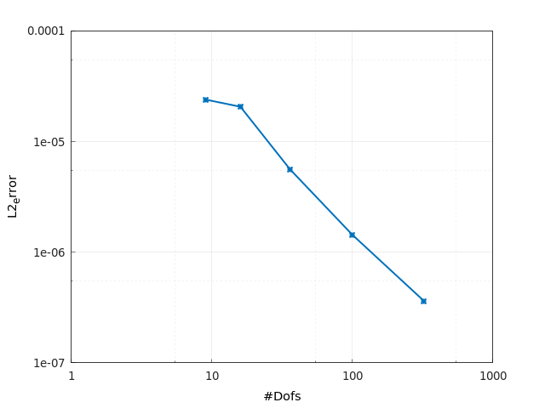
Ikarus with dune-iga
Simply Supported Plate with Distributed Load (Kirchhoff Plate Model)

Slide 8
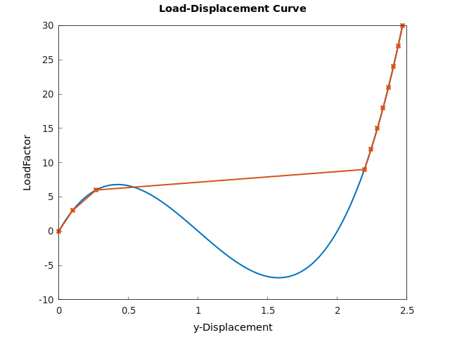
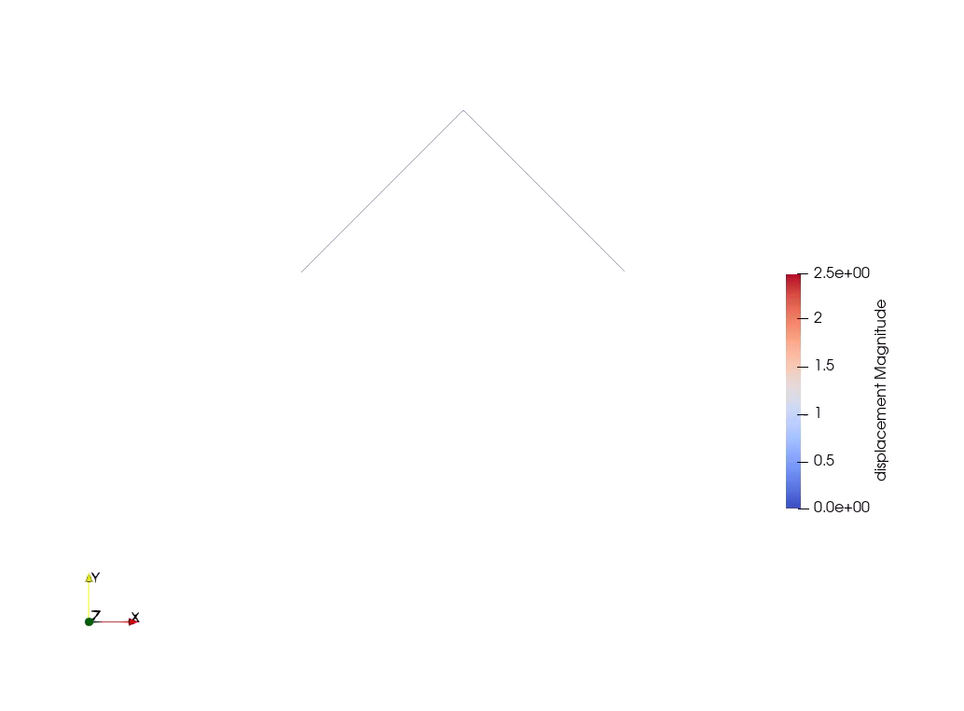
Ikarus with dune-iga
Von Mises Truss

Slide 9
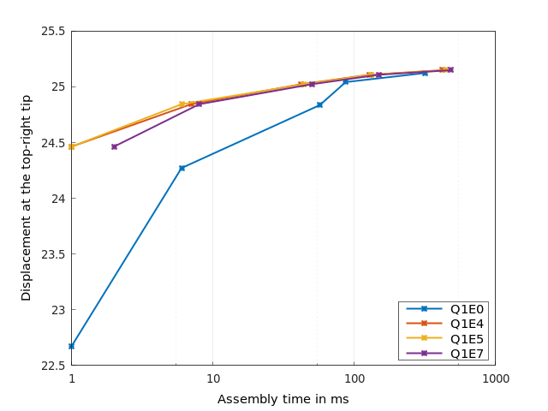
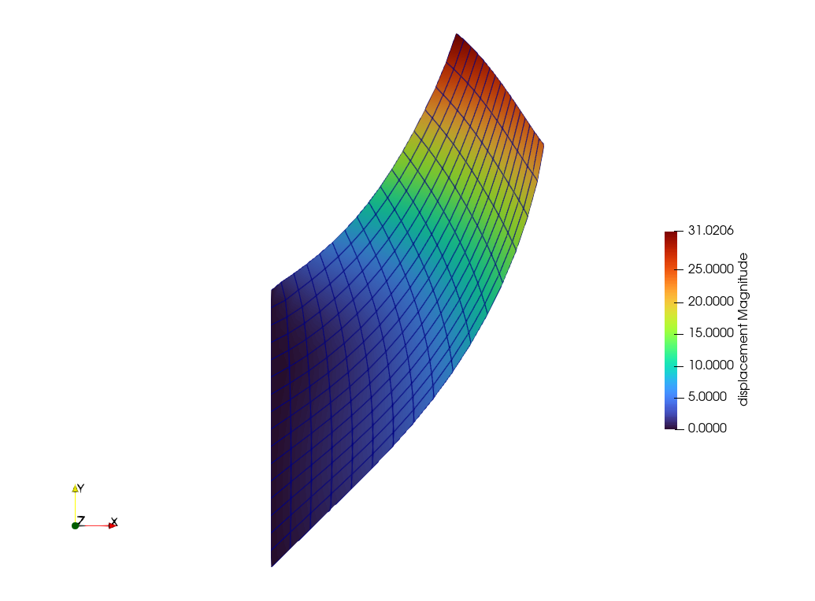
Ikarus with dune-iga
Cook’s Membrane

Slide 10
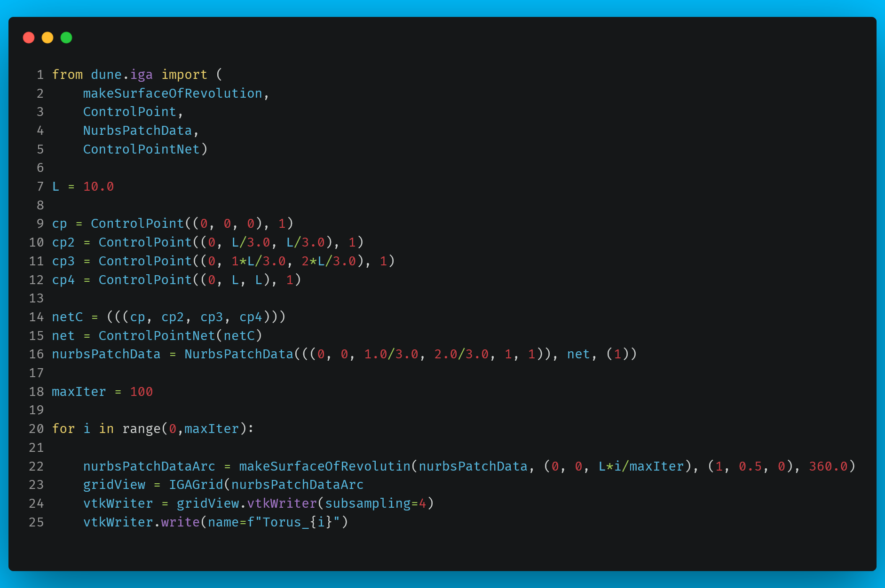
Ikarus with dune-iga
Surface Of Revolution
Notes:
https://carbon.now.sh/?bg=rgba%280%2C190%2C255%2C1%29&t=theme%3Ax870rf3awkf&wt=none&l=python&width=941&ds=true&dsyoff=20px&dsblur=68px&wc=true&wa=false&pv=18px&ph=9px&ln=true&fl=1&fm=Fira+Code&fs=13.5px&lh=147%25&si=false&es=2x&wm=false&code=from%2520dune.iga%2520import%2520%28%250A%2520%2520%2520%2520makeSurfaceOfRevolution%252C%250A%2520%2520%2520%2520ControlPoint%252C%250A%2520%2520%2520%2520NurbsPatchData%252C%250A%2520%2520%2520%2520ControlPointNet%29%250A%250AL%2520%253D%252010.0%250A%250Acp%2520%253D%2520ControlPoint%28%280%252C%25200%252C%25200%29%252C%25201%29%250Acp2%2520%253D%2520ControlPoint%28%280%252C%2520L%252F3.0%252C%2520L%252F3.0%29%252C%25201%29%250Acp3%2520%253D%2520ControlPoint%28%280%252C%25201*L%252F3.0%252C%25202*L%252F3.0%29%252C%25201%29%250Acp4%2520%253D%2520ControlPoint%28%280%252C%2520L%252C%2520L%29%252C%25201%29%250A%250AnetC%2520%253D%2520%28%28%28cp%252C%2520cp2%252C%2520cp3%252C%2520cp4%29%29%29%250Anet%2520%253D%2520ControlPointNet%28netC%29%250AnurbsPatchData%2520%253D%2520NurbsPatchData%28%28%280%252C%25200%252C%25201.0%252F3.0%252C%25202.0%252F3.0%252C%25201%252C%25201%29%29%252C%2520net%252C%2520%281%29%29%250A%250AmaxIter%2520%253D%2520100%250A%250Afor%2520i%2520in%2520range%280%252CmaxIter%29%253A%250A%250A%2520%2520%2520%2520nurbsPatchDataArc%2520%253D%2520makeSurfaceOfRevolutin%28nurbsPatchData%252C%2520%280%252C%25200%252C%2520L*i%252FmaxIter%29%252C%2520%281%252C%25200.5%252C%25200%29%252C%2520360.0%29%250A%2520%2520%2520%2520gridView%2520%253D%2520IGAGrid%28nurbsPatchDataArc%250A%2520%2520%2520%2520vtkWriter%2520%253D%2520gridView.vtkWriter%28subsampling%253D4%29%250A%2520%2520%2520%2520vtkWriter.write%28name%253Df%2522Torus_%257Bi%257D%2522%29

